Slide 1
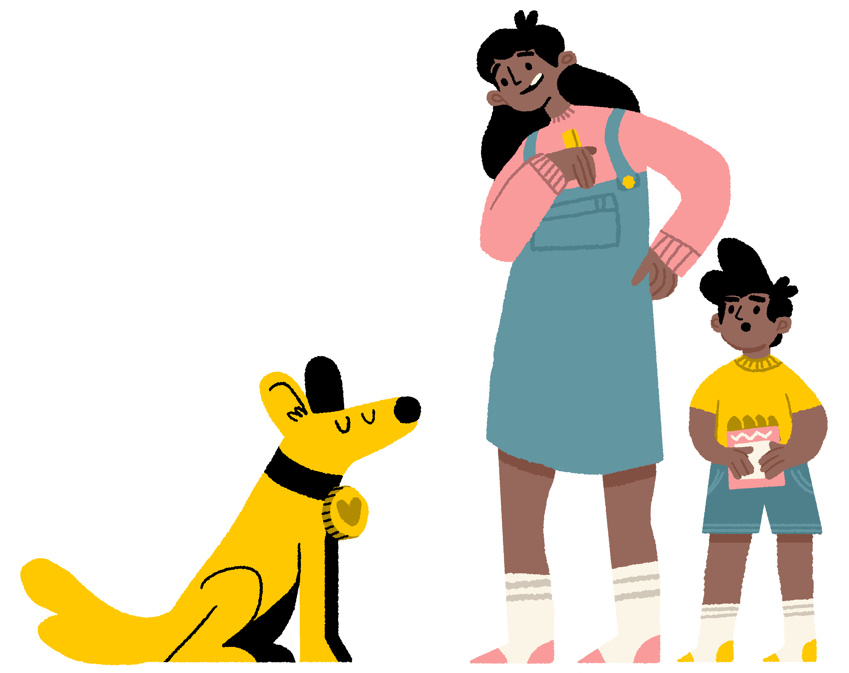
How have dogs changed
over time?
As a class, look at the pictures of different dog breeds.
The first picture is the breed of dog in the past, and the second is how that breed looks today.
List the differences you see in each of the dogs’ appearance.
learnwithdogstrust.org.uk ©Dogs Trust 2023 Registered charity numbers: 227523 & SC037843 A dog is for life®
Notes:
Please refer to teacher notes for more information and prompts to develop whole class discussion.

Slide 2
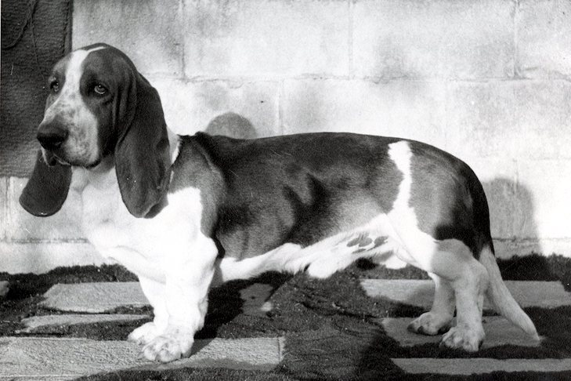
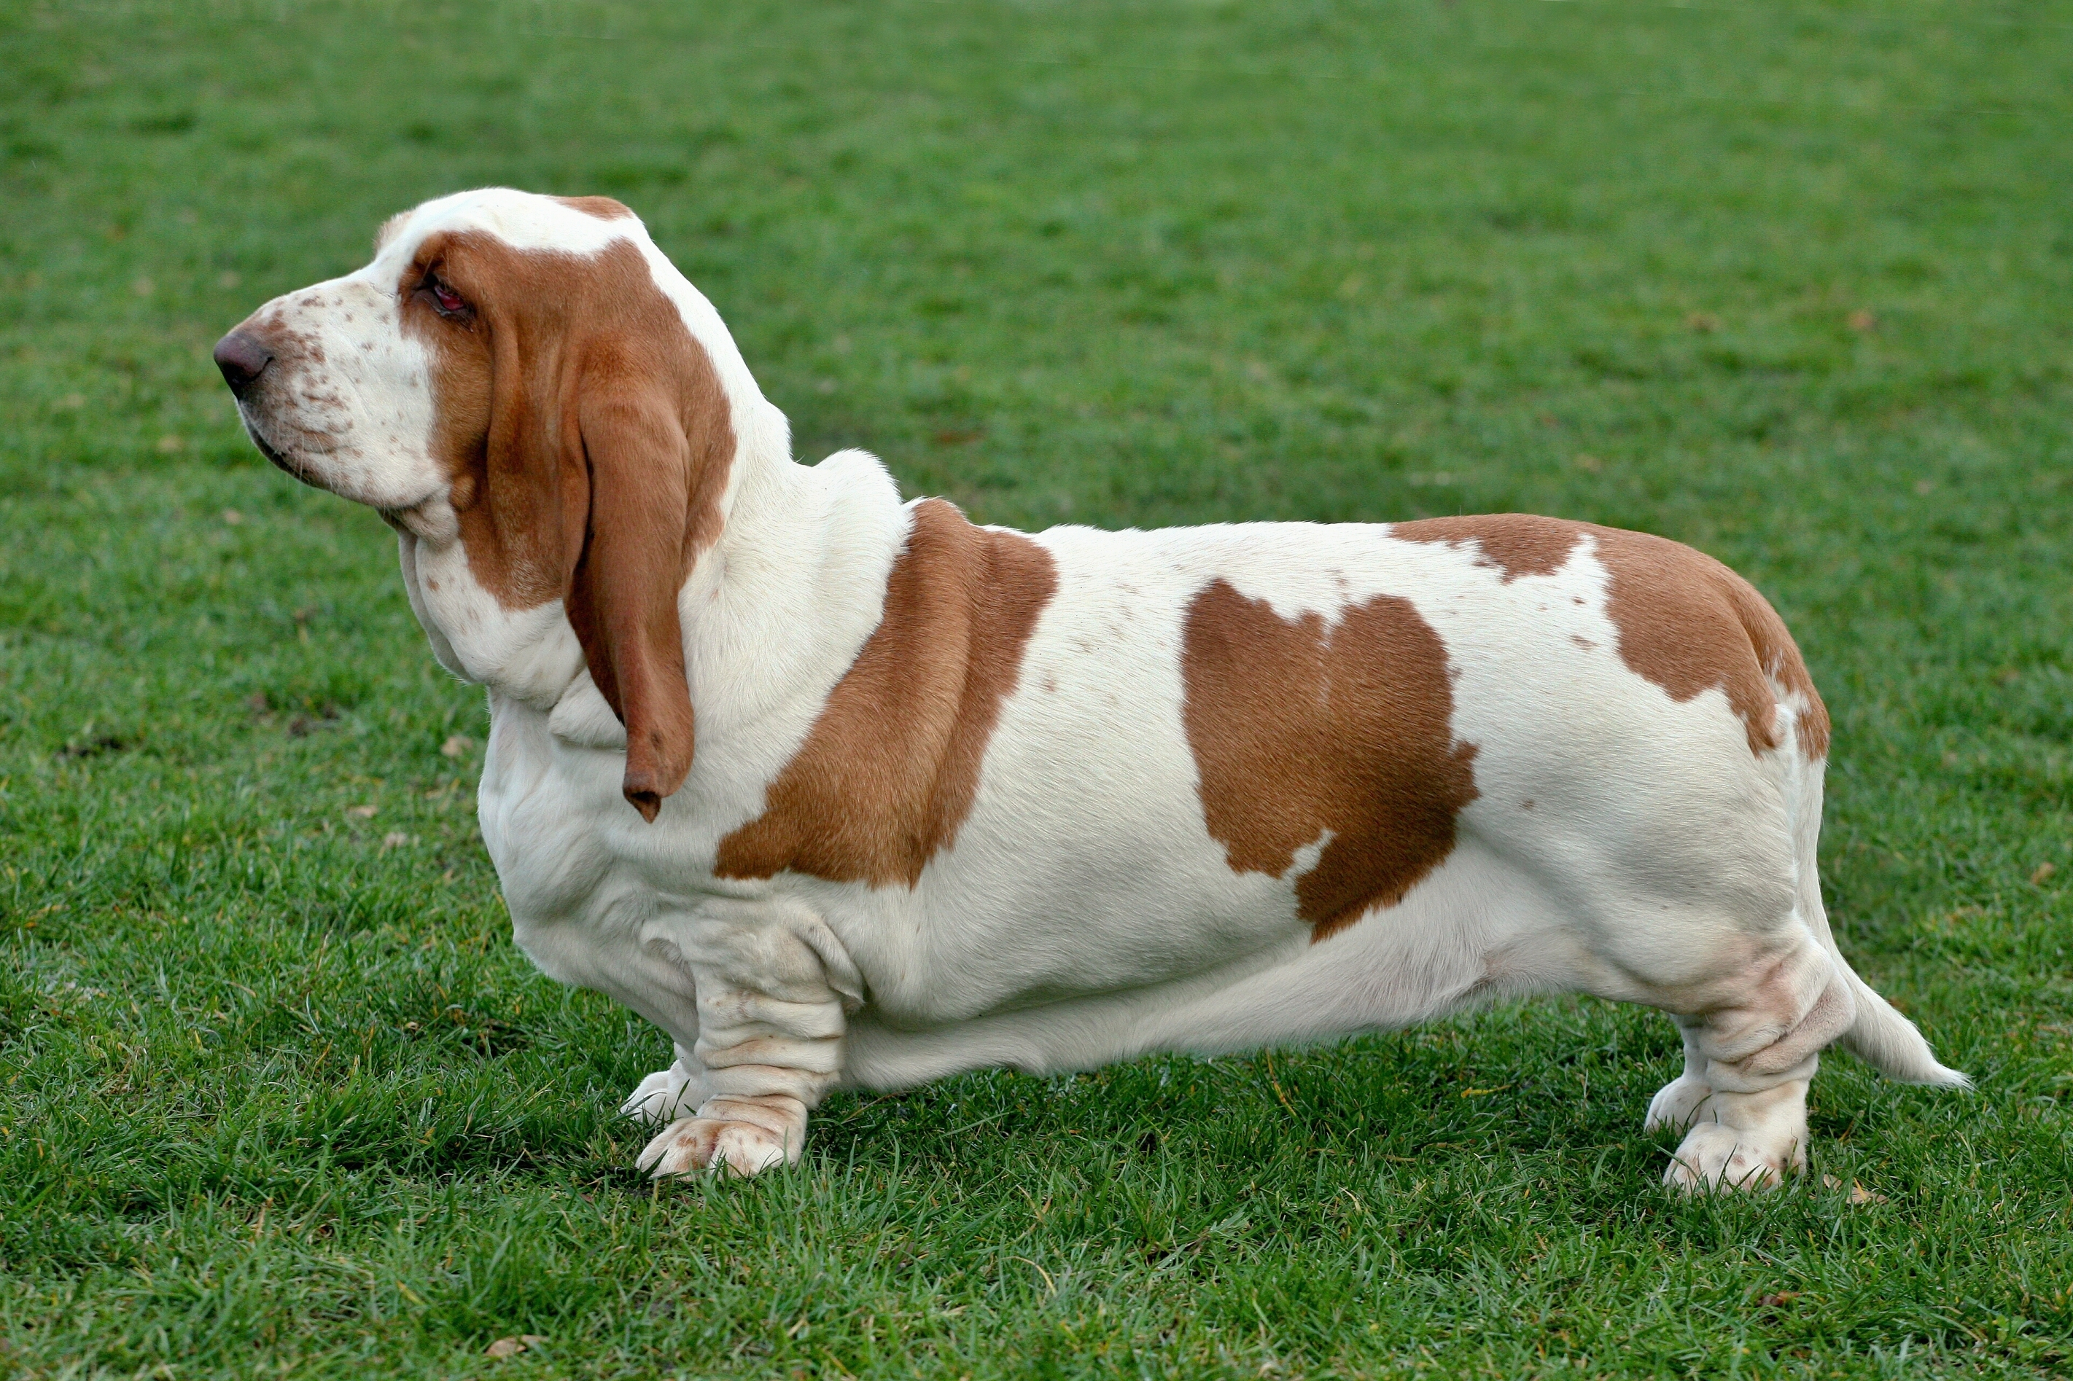
Basset Hound
Past
Present
Notes:
The Basset Hound today has a droopier face with more wrinkles and folds of skin. Their bellies are much lower to the ground, and their rear legs are shorter. They have excessive skin and large floppy ears.

Slide 3
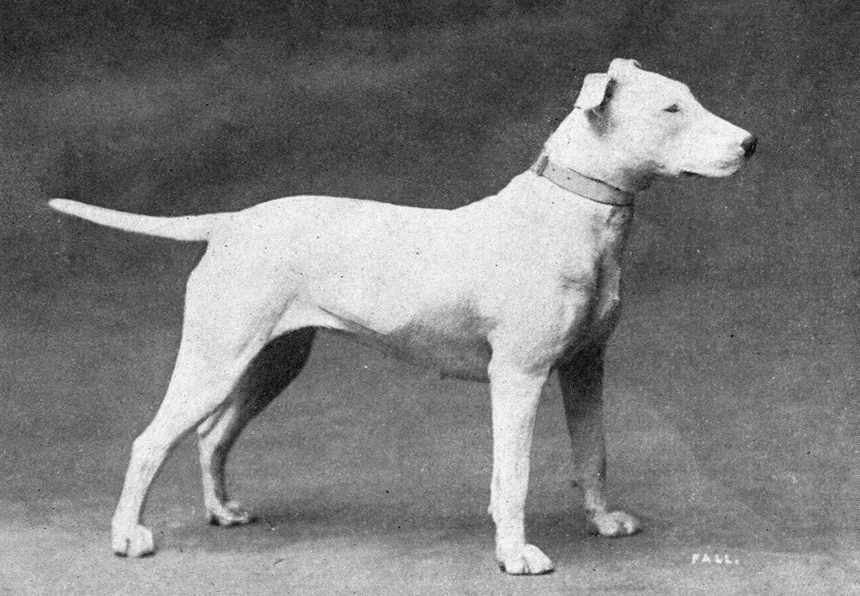
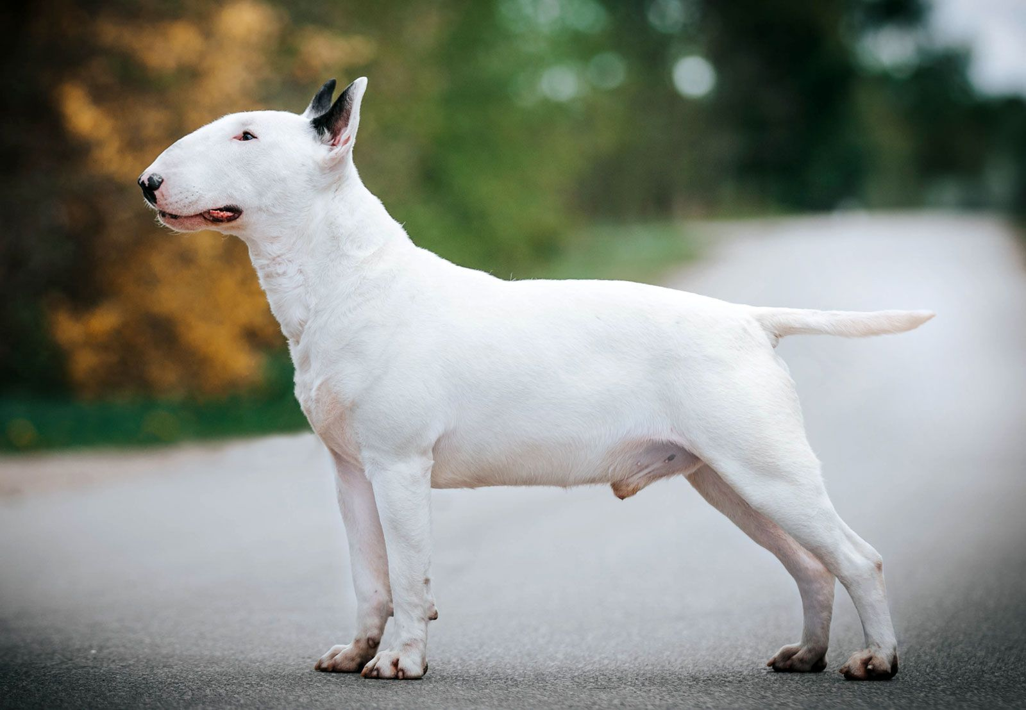
English Bull Terrier
Past
Present
Notes:
The English Bull Terrier has a dome-shaped head and triangle eyes. They are also heavier and more thick body.

Slide 4
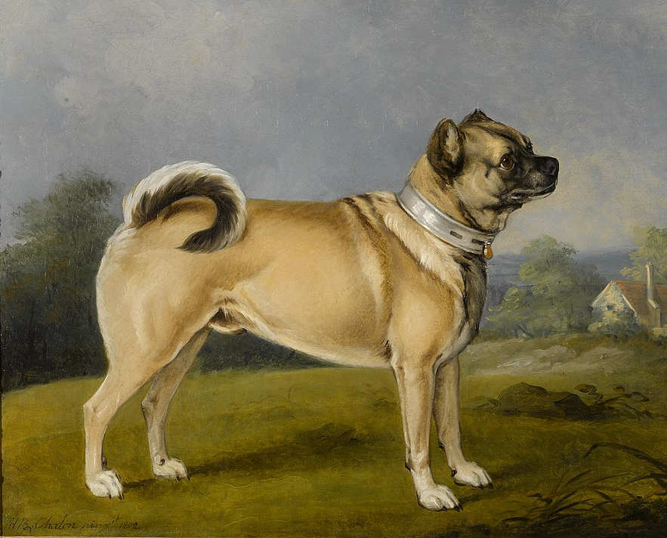
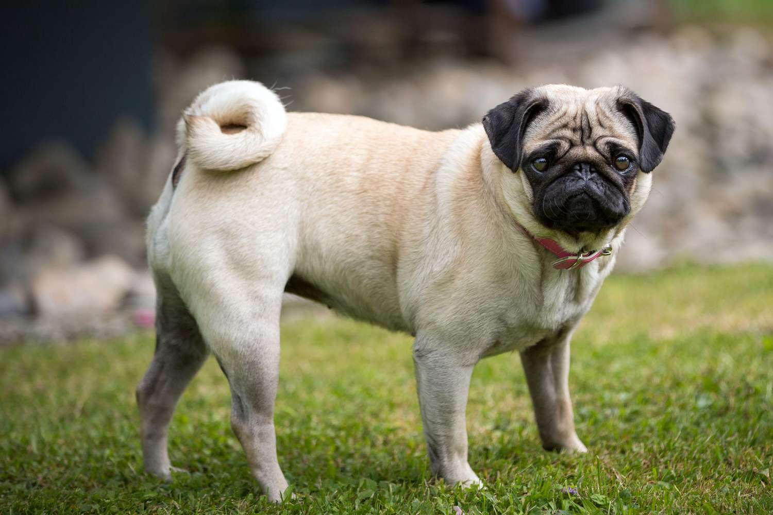
Pug
Past
Present
Notes:
The Pug has a much shorter, flatter face. They also have more wrinkles, skin folds and a double curved tail.

Slide 5
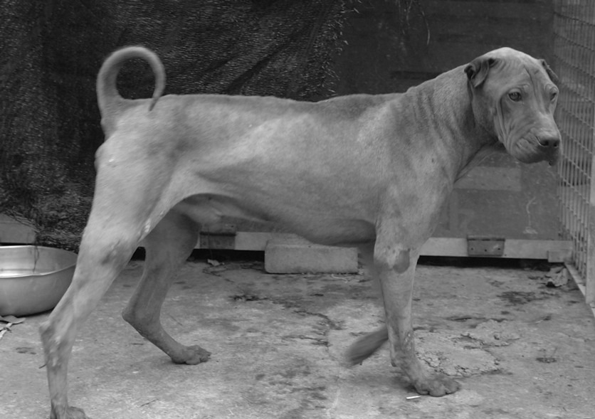
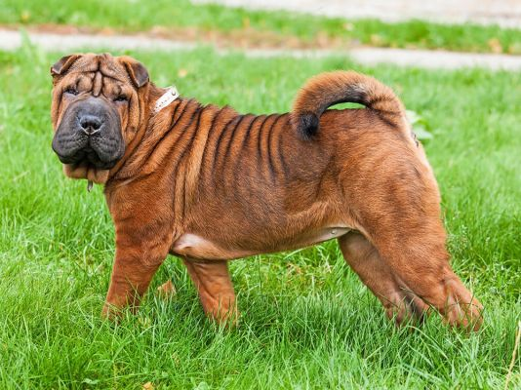
Sharpei
Past
Present
Notes:
The Sharpei today has more wrinkles and skin folds, especially around the face. The ears are smaller, and the dog is heavier and thicker.

